Slide 1
UNIT V – SDN Implementation and Mobile Networks
UNIT I – SESSION 1
SESSION 2
  Switch Implementations
  Controller Implementations
  SDN Applications
  Simulation, Testing, and Tools
  OpenStack
  Example: Applying SDN Open Source Reference: Ref. 1, Ch.11.5 to 11.7, 11.9, 11.10, 11.11

Slide 2
Switch Implementations
The open source switch implementations can potentially apply both to OpenFlow hardware device implementations as well as software-based virtual switches.
Two most widely discussed switch implementations, OVS and Indigo, as well as the only OpenFlow wireless access point code base listed, Pantou.
OVS is the most mature and feature-complete open source implementation of the switch side of an OpenFlow implementation.
OVS has been used as the control logic inside genuine hardware switches as well as a virtual switch running within a hypervisor to implement network virtualization.
OVS uses OpenFlow for control of flows and OVSDB for configuration.
OVS uses the sFlow protocol for packet sampling and monitoring.
The code has been ported to multiple switching chipsets and has thus found a home in several hardware switches as well.

Slide 3
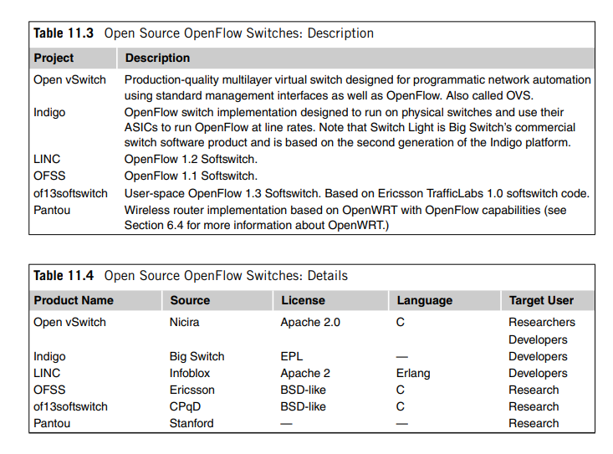
Switch Implementations

Slide 4
Switch Implementations
Big Switch Networks offers the Indigo switch code base under the Eclipse public license.
Like OVS, Indigo is targeted for use both on physical switches as well as an OpenFlow hypervisor switch for network virtualization environments.
In particular, this code can be used to convert a legacy layer two or three switch into an OpenFlow switch.
By making this code base available to switch manufacturers, especially smaller manufacturers that may lack the means to develop their own OpenFlow switch-side control code, Big Switch hopes to expand the market for its controller.
Because Indigo is integrated with Ethernet switch ASICs, it is possible to switch flows under the OpenFlow paradigm at line rates.

Slide 5
Switch Implementations
Distinction between OVS and Indigo
Indigo is implemented specifically to support OpenFlow, whereas OVS can support other control mechanisms such as OVSDB.
In addition, OVS has broader support for affiliated network virtualization features than Indigo and includes richer contributions from the open source community.
Nevertheless, after OVS, Indigo remains a more likely candidate for an open source starting point for a commercial OpenFlow physical switch than the alternatives.
From a feature-set point of view, OVS seems to be a superset of Indigo’s features.

Slide 6
Switch Implementations
Pantou is actually designed to turn commodity APs into an OpenFlow-enabled AP.
This is accomplished by integrating the NOX OpenFlow implementation with OpenWRT.
OpenWRT is an open source project that applies the SDN principle of opening up the device to a wide selection of low-cost consumer AP hardware.
This union of OpenFlow with basic wireless AP functionality available on low-cost hardware is a boon to researchers who want to experiment with the largely virgin field of SDN applied to 802.11 networks.

Slide 7
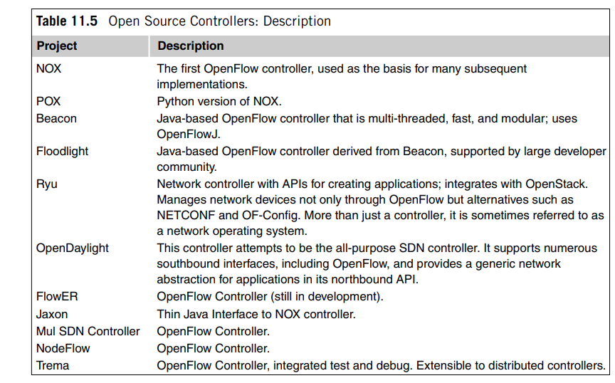
Controller Implementations

Slide 8
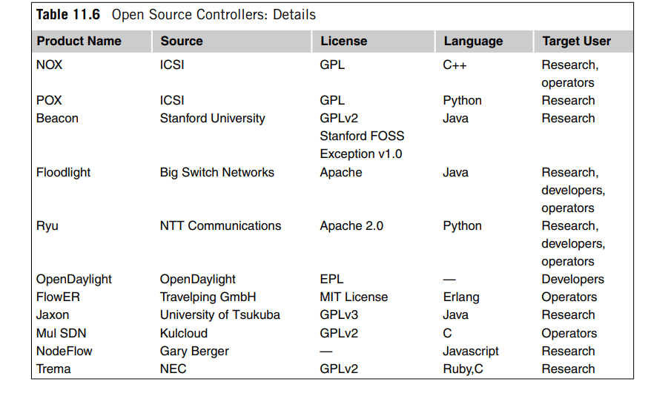
Controller Implementations

Slide 9
Controller Implementations – Beacon
The Beacon controller was based on OpenFlowJ, an early open source implementation of OpenFlow in Java.
The OpenFlowJ project is hosted at Stanford University.
Beacon is a highly influential controller, both for the large amount of early OpenFlow research and development that was done on that controller as well as being the code base from which the Floodlight controller source code was forked.
Beacon is a cross-platform, modular OpenFlow controller.
Beacon has been successfully deployed in an experimental data center consisting of 20 physical switches and 100 virtual switches.
It runs on many different platforms, including high-end Linux servers.

Slide 10
Controller Implementations – Beacon
Though the core controller code is protected with GPL-like terms, the FOSS license exception allows developers to extend the controller with applications that may be licensed under more commercially favorable terms.
Beacon’s stability distinguishes it from other controllers used primarily for research purposes.
Modules of Beacon can be started, stopped, and even installed while the other components of Beacon continue operating.
Evidence of the impact that this code base has had on the OpenFlow controller industry is found in the names of the two most influential open source controllers being used by industry today, Floodlight and Open Daylight, both echoing the illumination connotation of the name Beacon.

Slide 11
Controller Implementations – Floodlight
Floodlight was forked from Beacon prior to Beacon being offered under the current GPL/FOSS licensing model .
Because Floodlight itself is licensed under the Apache 2.0 license, it is not subject to the copyleft provisions of the Beacon license, and the source is thus more likely to be used by recipients of the code who need to protect the intellectual property of their derivative works on the code base.
Floodlight is also integrated with OpenStack.
A number of commercial OpenFlow controllers are being developed using Floodlight as the starting point.
This includes Big Switch’s own commercial controller, Big Network Controller.
Big Switch’s business strategy surrounding the open source controller is complex. The company offers a family of applications that work with the Floodlight controller.

Slide 12
Controller Implementations – Floodlight
Though its commercial controller will not be open source, the company promises to maintain compatibility at the interface level between the commercial and open source versions.
Big Switch joined the Open Daylight project, donating its Floodlight controller to the effort in hopes that this action would further propagate Floodlight.

Slide 13
Controller Implementations – Open Daylight Project
The OpenDaylight project was formed in early 2013 to provide an open source SDN framework.
The platinum-level sponsors included Cisco, Brocade, Ericsson, Citrix, Microsoft, and Big Switch Networks.
Unlike the ONF, OpenDaylight only considers OpenFlow to be one of many alternatives to provide software control of networking gear.
Big Switch initially joined and donated its Floodlight controller to OpenDaylight, anticipating that Floodlight would become the key OpenFlow component of the project.
This expectation was quickly shattered as OpenDaylight decided to make the Cisco Open Networking Environment (ONE) controller the centerpiece and to merely add Floodlight technology to that core. (Cisco now markets a commercial version of the ONE controller as the Extensible Network Controller, or XNC.)

Slide 14
Controller Implementations – Open Daylight Project
Subsequent to this, Big Switch reduced its involvement in the OpenDaylight project and ultimately withdrew completely.
The XNC controller may use a variety of methods to control network devices.
It is thus noteworthy that both SDN via APIs and Open SDN are present in the same XNC controller.
The facts that Big Switch stepped back from its commitment to OpenDaylight, there is a total lack of coordination between the ONF and OpenDaylight, and the platinum sponsors are almost all incumbent network equipment manufacturers have all led to a growing skepticism about the compatibility of OpenDaylight with the ONF.

Slide 15
SDN Applications
The term applications by its very nature is general, so it is not possible to list all the possible categories of SDN applications.
Nevertheless, four major themes surface that have attracted the most early attention to SDN applications. These are security, routing, network management, and network functions virtualization (NFV).
Three examples related to routing: the BIRD; Quagga, and Routeflow.
Avior is a network management application for the Floodlight controller.
OpenFlow has great potential to provide the next generation of network security. The two relevant examples are FortNOX and Fresco.
NFV applications constitute the class of applications that virtualize a network services function that is performed by a standalone appliance in legacy networks.
Examples of such devices are traffic load balancers and intrusion detection systems. FlowScale is an NFV application that implements a traffic load balancer as an OpenFlow controller application.

Slide 16
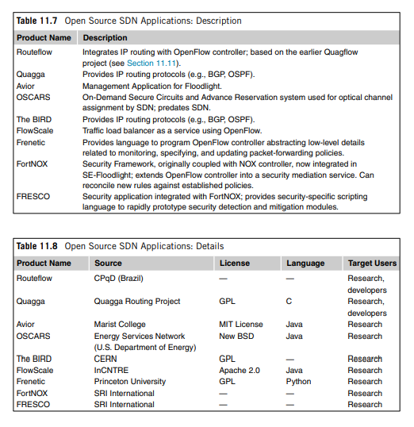
SDN Applications

Slide 17
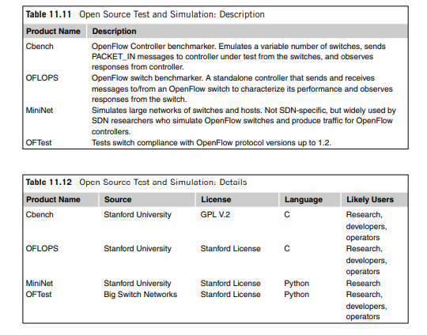
Simulation, Testing and Tools

Slide 18
Simulation, Testing and Tools
Cbench
OFLOPS
OFTEST.
Mininet used in a commercial setting, this tool has seen wide use by SDN researchers to emulate the large networks of switches and hosts and the traffic that can cause a controller, such as an OpenFlow controller, to create, modify, and tear down large numbers of flows

Slide 19
OpenStack
The OpenStack open source is a broad open source platform for cloud computing, released under the Apache license.
OpenStack provides virtualization of the three main components of the data center: compute, storage, and networking.
The compute function is called Nova. Nova works with the major available hypervisors to manage pools of virtual machines. Examples of the hypervisors that can be used with OpenStack include KVM, XenServer, and VMware, among others.
The storage functions are Swift and Cinder. Swift provides redundant storage such that storage servers can be replicated or restored at will, with minimum dependency on the commodity storage drives that provide the actual physical storage. Cinder provides OpenStack compute instances with access to file and block storage devices. This access can be used with most of the prevalent storage platforms found in cloud computing today.

Slide 20
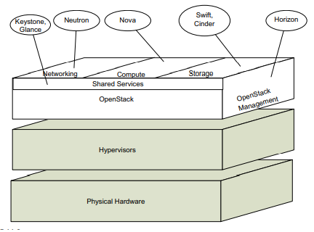
OpenStack

Slide 21
OpenStack
Horizon provides a dashboard to access, provision, and manage the cloud-based resources in an OpenStack environment.
There are two shared services, Keystone and Glance.
Keystone provides a user authentication service and can integrate with existing identity services such as LDAP.
Glance provides the ability to copy and save a server image such that it can be used to replicate compute or storage servers as services are expanded. It also provides a fundamental backup capability for these images.
The network virtualization component of OpenStack is provided by Neutron formerly known as Quantum.
Neutron’s role in OpenStack is embodied as a number of plugins that provide the interface between the network and the balance of the OpenStack cloud computing components.

Slide 22
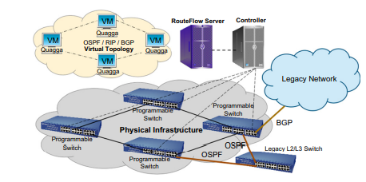
Example : Applying SDN Open Source
The RouteFlow project provides an excellent use case for open source SDN code.
The RouteFlow project has developed a complete SDN test network using only open source software.
The project uses to demonstrate their proposed migration path from networks of legacy routers to OpenFlow.
This is particularly important because it demonstrates a practical method of integrating the complex world of routing protocols with the OpenFlow paradigm

Slide 23
Example : Applying SDN Open Source
The major components described in the figure are listed below, along with the source of the software used to build the component:
Network (OpenFlow) controller: NOX, POX, Floodlight, Ryu
RouteFlow server: Developed in RouteFlow Project
Virtual topology RouteFlow client developed in RouteFlow Project
Virtual topology routing engine: Quagga routing engine, XORP
Virtual topology switches: OVS OpenFlow-enabled hardware switches: For example, NetFPGA
VMs in virtual topology: Linux virtual machines

Slide 24
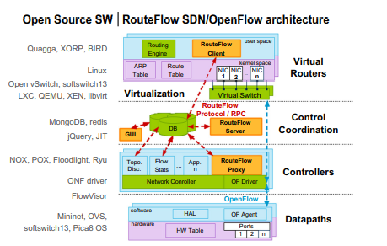
Example : Applying SDN Open Source

